Slide 1
Write your first Lightning Web Component
Taylor Ortiz
SF Dev Essentials Series
Denver Salesforce Developers Group

Slide 2
Agenda
About me
Salesforce History of Components
What are Lightning Web Components?
LWC Features
HTML Templates
Composition
Lifecycle Hooks
Decorators
Events
Lightning Data Service
Working with Apex
Quiz
Workshop

Slide 3
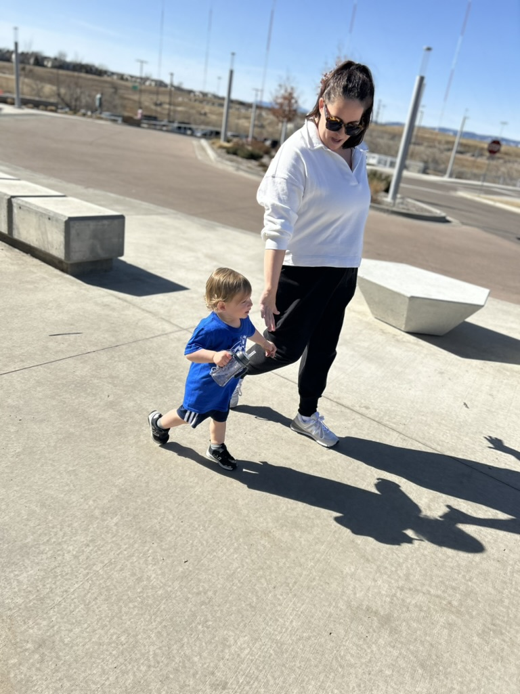
About me
12+ year software engineer
Enterprise Architect
Salesforce, ETL, AWS, GCP & Azure
Data engineer & architect
Snowflake, Databricks
Started career with Paul at Apto
UT Austin alum (Hook ‘em)
My life and passion is my family

Slide 4
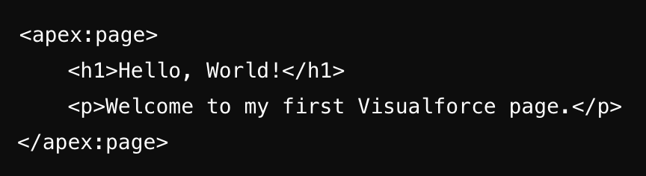
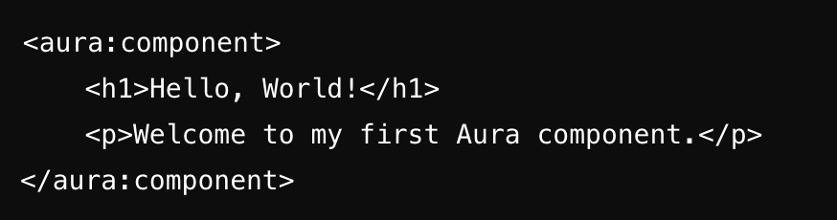
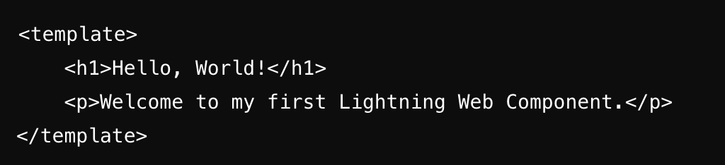
Salesforce History of Components
Visualforce
Introduced in 2008
Tag based markup
Page centric model
Server-side rendering
Data binding
Aura Components
Introduced in 2014
Tag based markup
Component-based model
Client-side rendering
Two way data binding
LWC
Introduced in 2019
Modern web standards
Faster & lighter
ES6 JS modules

Slide 5



What are Lightning Web Components?
A Lightning web component is a reusable custom HTML element with its own API.
Easier debugging
Component based architecture
Easy to integrate with existing Lightning components
Works across all browsers, removing the need for polyfills
Anatomy of an LWC component:
Component.js
Component.js-meta.xml
Component.html
Component.css

Slide 6
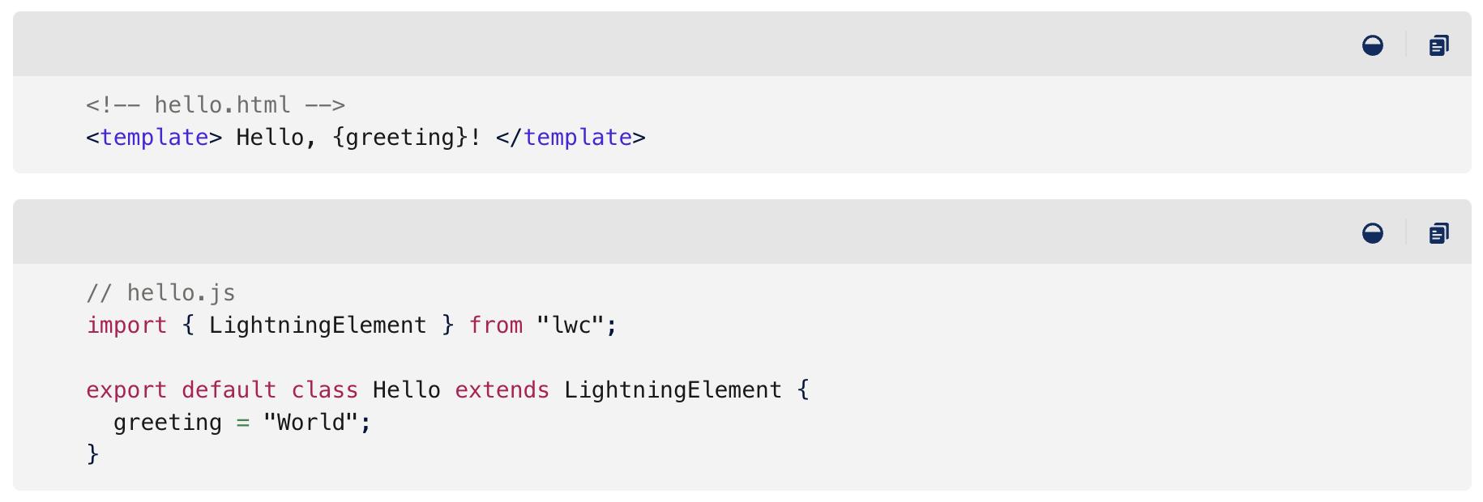
LWC Features: HTML Templates
Use standard HTML elements
<div/>
Data binding
{greeting}
Conditional Rendering & Loops
If:true
For:each
Template scope (Shadow DOM)

Slide 7
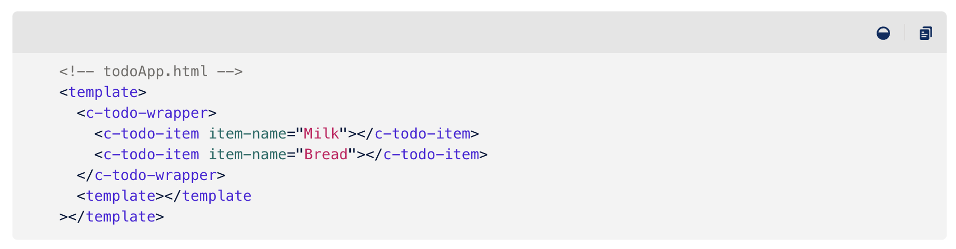
LWC Features: Composition
Component based architecture
Parent and child components
Pass data from parent to child (@api)
Call methods on child components
Pass set of properties with lwc:spread
Reusability
Out of the box LWC component library
Event propagation

Slide 8
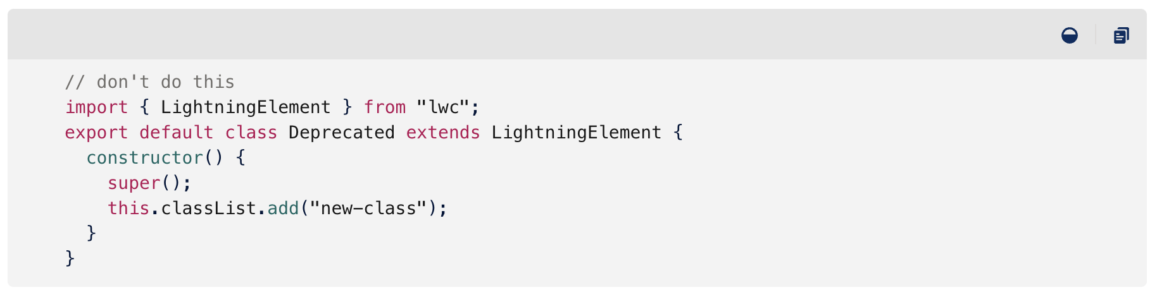
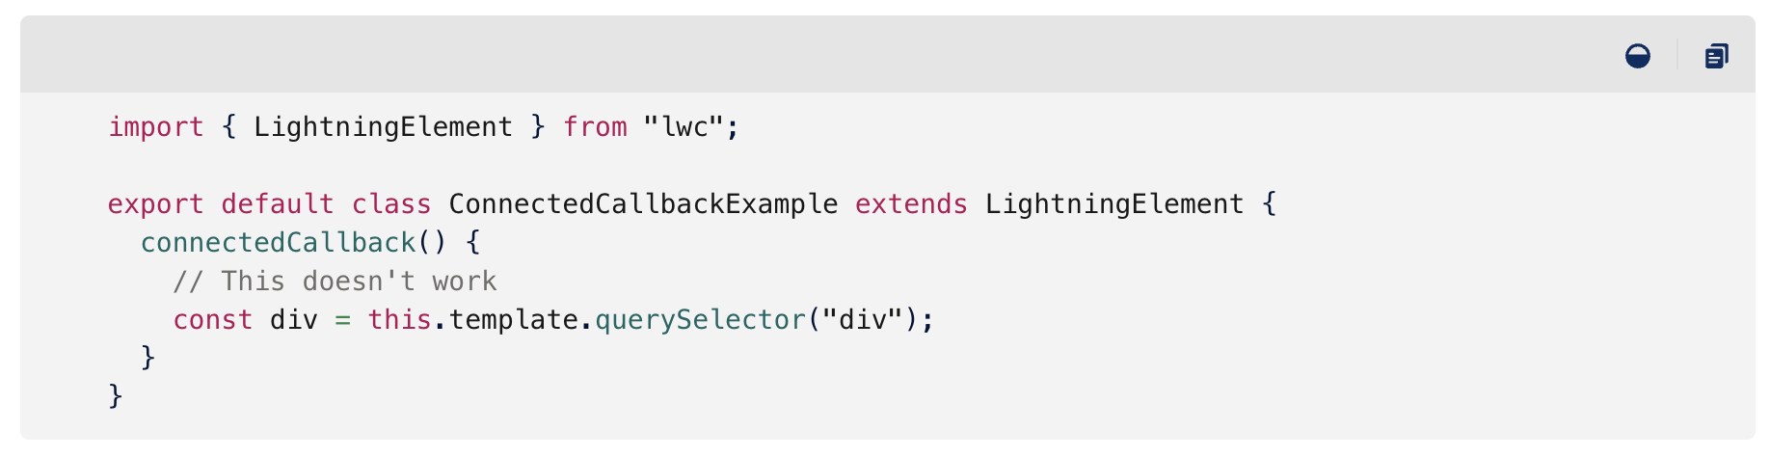
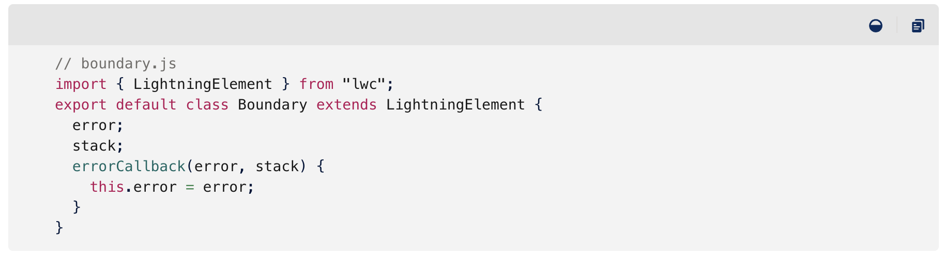
LWC Features: Lifecycle Hooks
constructor(): fires when a component instance is created
connectedCallback(): fires when component is inserted into the DOM
disconnectedCallback(): fires when a component is removed or hidden from the DOM
renderedCallback(): perform logic after component has finished rendering phase
render(): to update the UI
errorCallback(): catch errors that occur in these lifecycle hooks

Slide 9
LWC Features: Decorators
@api: to expose a property publicly
@track: before 2020, you had to use the @track decorator to make a field reactive. All fields are now reactive. Situations where you still need to use @track:
Observing changes to the properties of an object
Observing changes to the elements of an array
@wire:
Read data being retrieved through Lightning Data Service
Read data in certain use cases retrieved through Apex

Slide 10
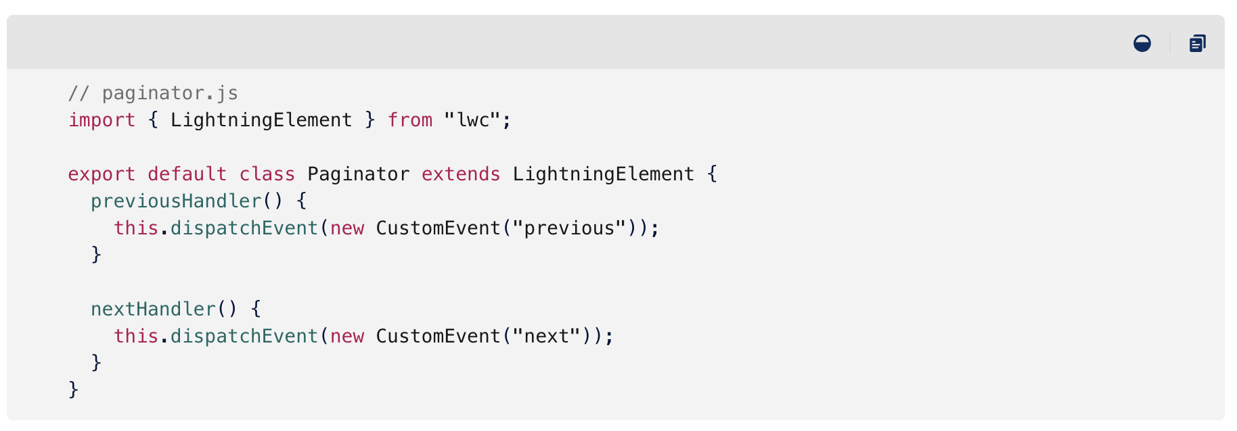
LWC Features: Events
Propagate events from children to parent
Types of event propagation:
Bubbling events: bubble up through parents until reaching the DOM
Non-bubbling events: confined to the component that dispatches them
Two ways to handle events:
Declarative event listener
onnotification={handleNotification}
Programmatic event listener
this.template.addEventListener("notification", this.handleNotification);

Slide 11
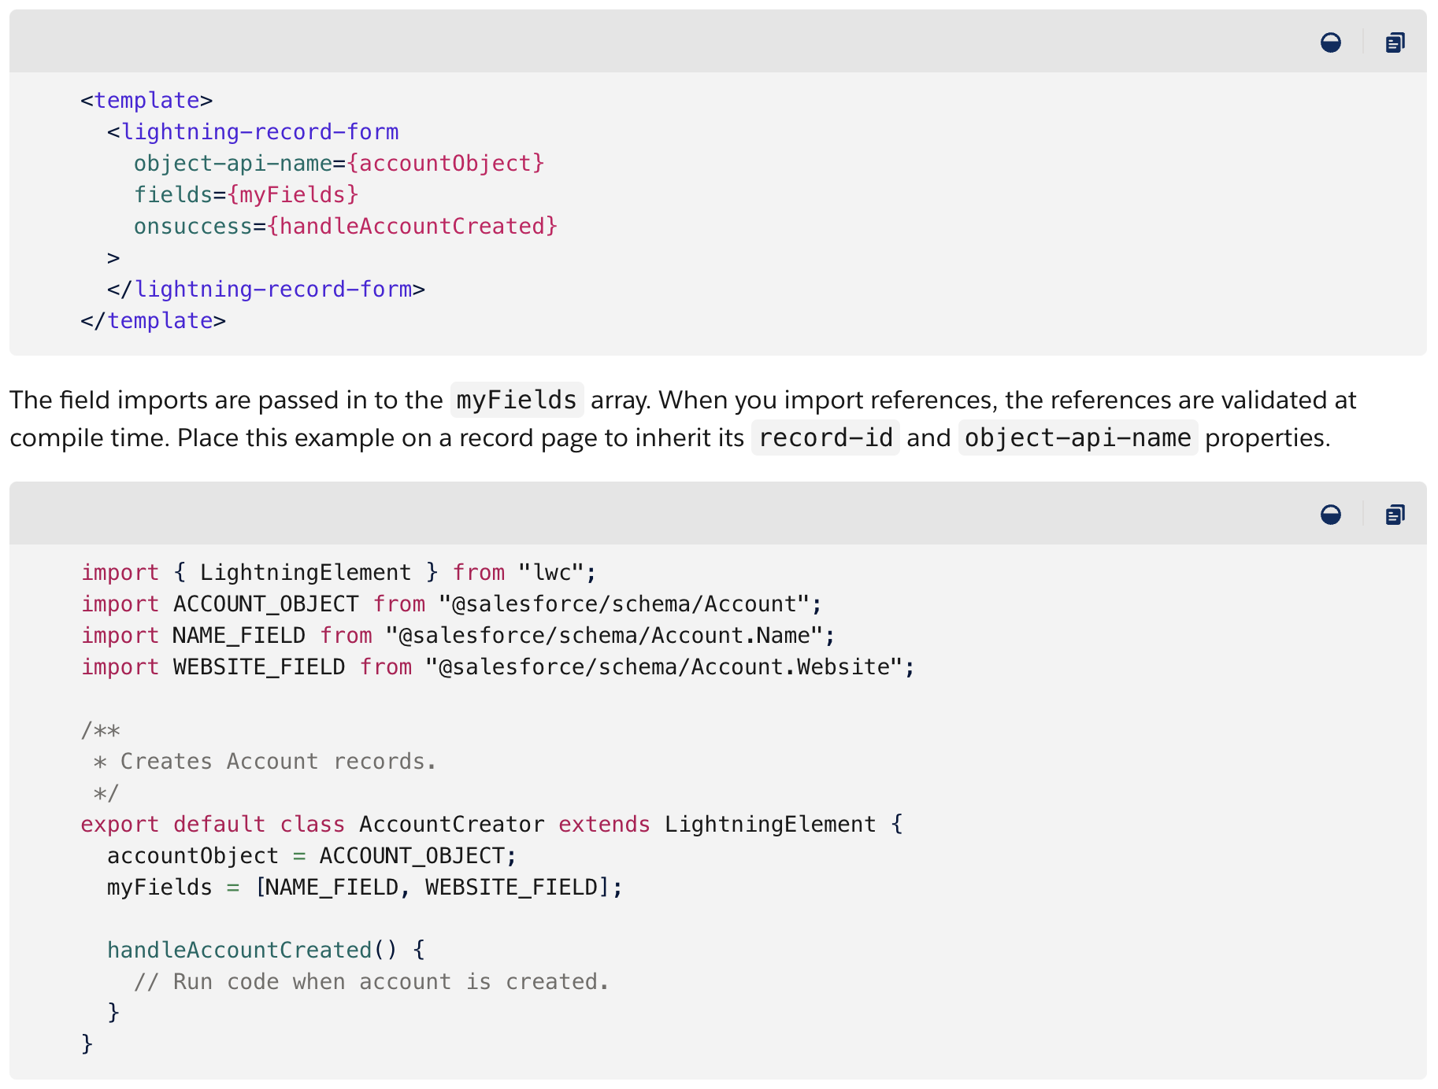
LWC Features: Lightning Data Service
Simplified Data Access
Base components: <lightning-record-edit-form/>
No apex required for basic operations
Built-in security respecting user access
Loads record data progressively
Caches results on the client
Invalidates cache when Salesforce data changes
Optimizes server calls
Supports @wire decorator for simple system interactions

Slide 12
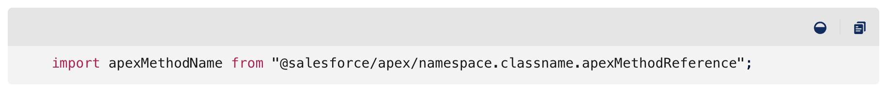
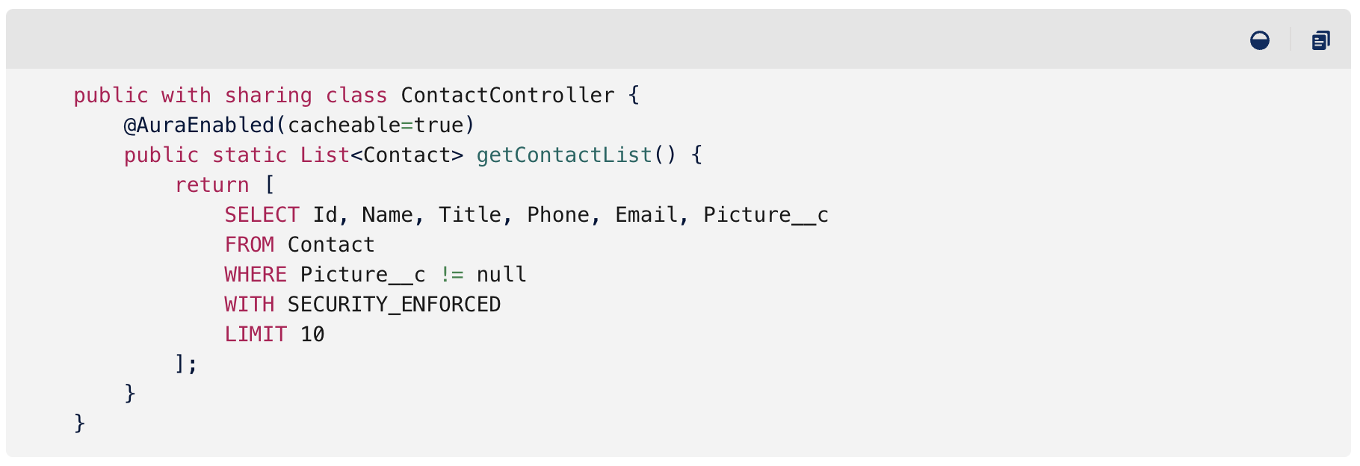
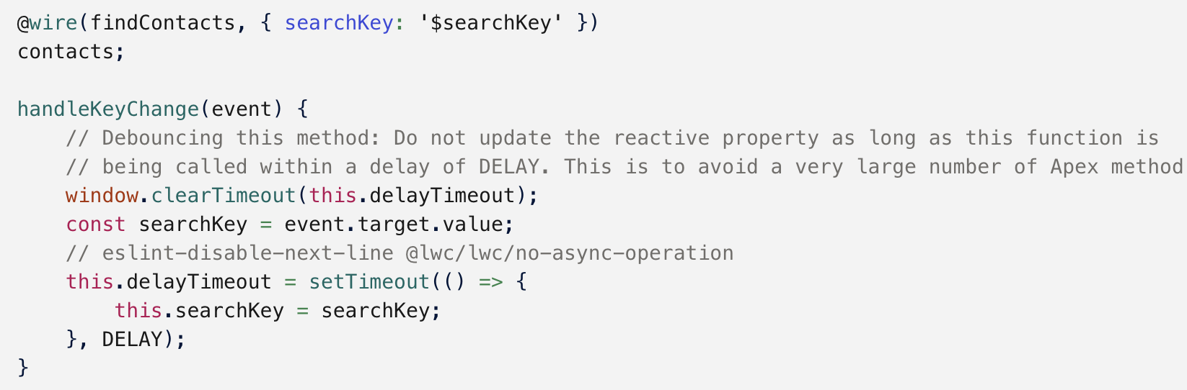
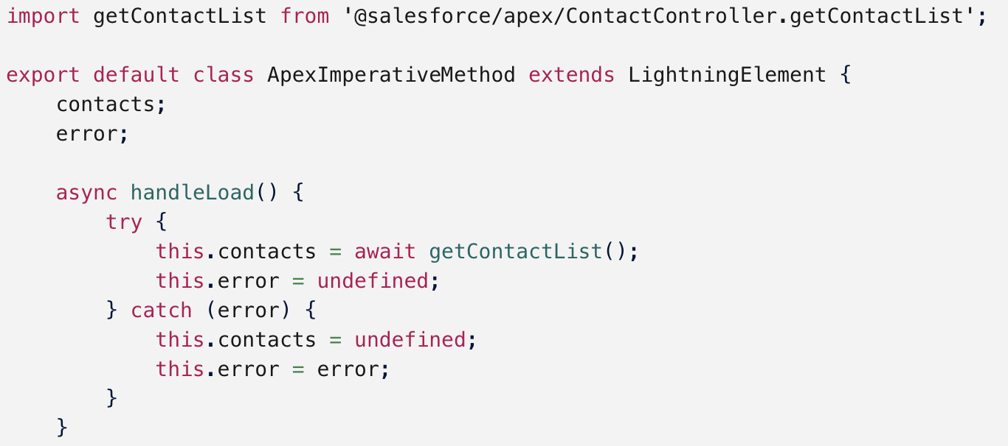
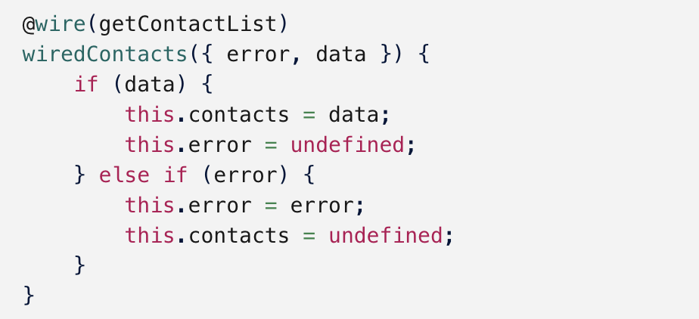
LWC Features: Working with Apex
1
Importing Apex methods (1)
Expose Apex methods to LWC (2)
Wire Apex methods to components
Wire to property
Wire with a dynamic parameter (3)
Wire with complex parameters like a wrapper object
Wire to a function (4)
Call Apex imperatively (5)
2
3
4
5

Slide 13
Quiz
Question 1: What are the three main files that make up a Lightning Web Component’s anatomy?
Component.js, Component.html, Component.xml
Component.js, Component.html, Component.js-meta.xml
Component.js, Component.html, Component.css
Question 2: In Lightning Web Components, what is the primary purpose of the @api decorator?
To make a field reactive
To make a property public
To wire data from the database
Question 3: Which type of event propagation in LWC allows the event to bubble up through parent components until it reaches the DOM?
Capturing events
Non-bubbling events
Bubbling events

Slide 14
Workshop
https://bit.ly/3UimFcU

